Slide 1
Forums
(FORUM)

Slide 2

Forums
A troll is a user that repeatedly and intentionally breaches netiquette, often posting derogatory or otherwise inflammatory messages about sensitive topics in an established online community to bait users into responding. They may also link to shock sites or plant images on networks that others may find disturbing in order to cause confrontation. Trolls known as gravediggers purposefully post in old and irrelevant threads simply to bring that thread to light again

Slide 3
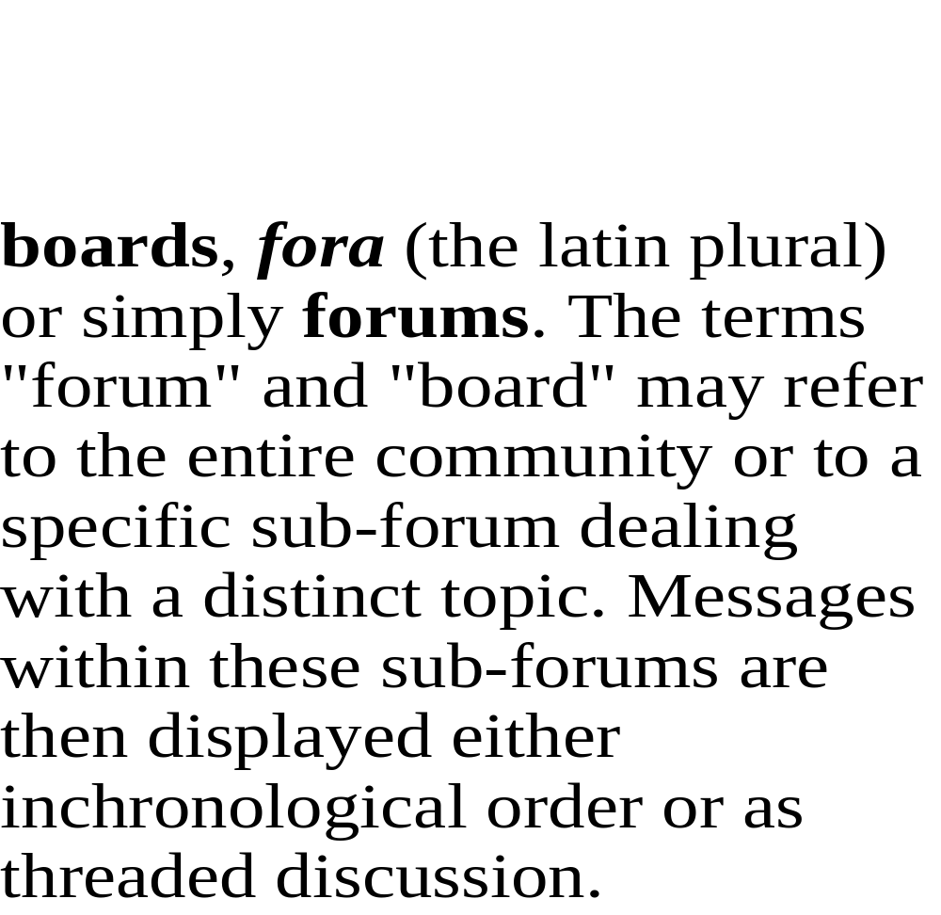
Forums

Slide 4
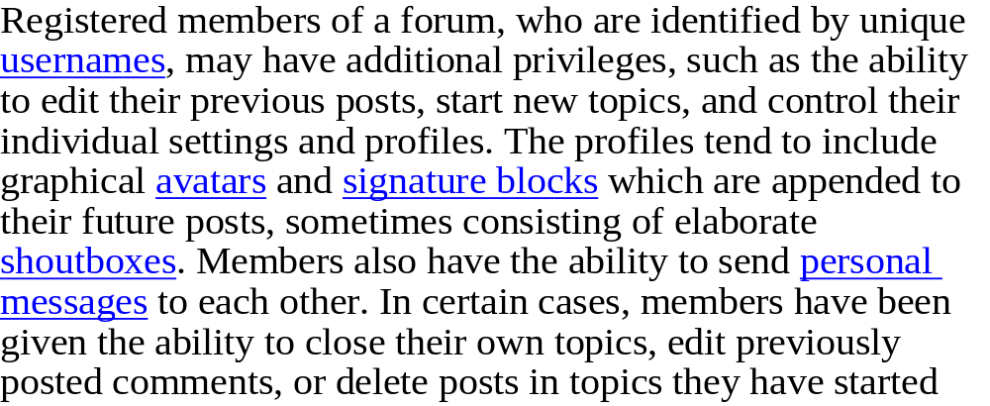

Forums

Slide 5
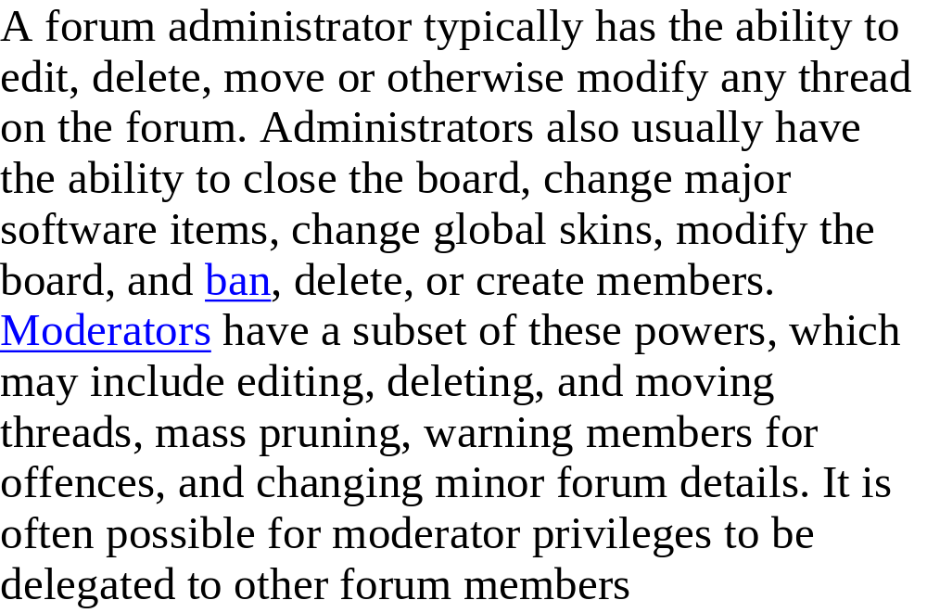
Forums

Slide 6
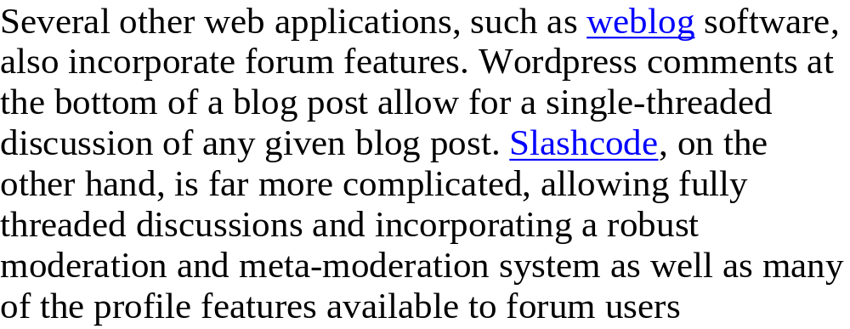


Slide 7
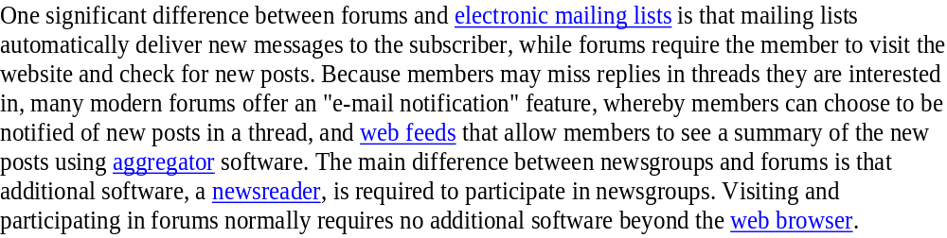

Forums

Slide 8


Slide 9
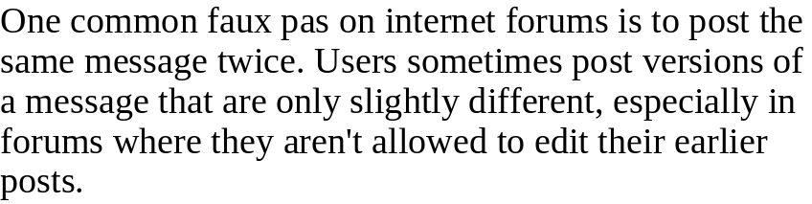
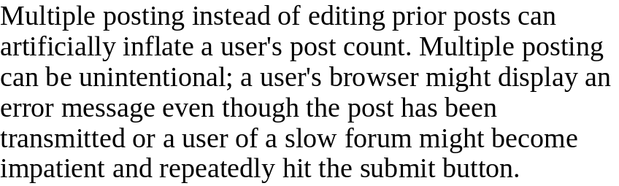


Forum

Slide 10

FORUMS

Slide 11

By:Lavdim Ibrahimi
9/F

